Slide 1
Preparing for finals
Center for student success

Slide 2
How do you feel about finals?

Slide 3
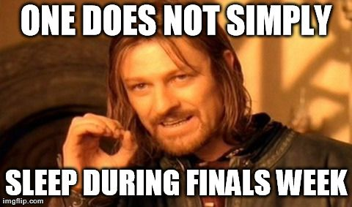

Slide 4
This presentation will cover…
How to plan for finals
How to take care of yourself during finals

Slide 5
First things first: gather information
Start now!
Gather all info on finals:
When is your final?
What format is your final?
Is it cumulative? What does it cover?
Types of questions: true/false, multiple choice, essay, etc.
Where do you find this?

Slide 6
Plan your time
Now that you know WHAT you need to do, plan how to do it
Work backwards to plan each final
Create writing and/or study plan
Write down your plan!

Slide 7
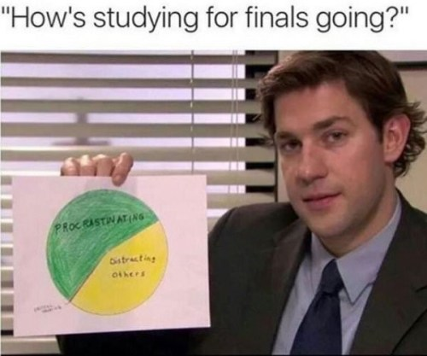
Tips for planning: Reading days
“Reading Days”
During finals week, but shouldn’t have finals due
Your time to study and write
Don’t wait until Reading Days to start prepping for finals!
Plan time for self care and breaks

Slide 8
Tips for planning
Be realistic about time-tables
Know how long it takes you to complete different types of work
Learn from previous tests or papers
What types of studying works for that professor?
How is project/paper weighted?
Write all assignments and plans in one place
See overlap in assignments
Can plan your time in segments
Try to refrain from marathon sessions
Be honest about attention span
Block chunks in day, especially during reading days
Work on different finals to keep yourself engaged

Slide 9
Planning for tests
Collect materials
Make area of study space dedicated to each final
Put all notes, notecards, books, articles, material together
Find what’s missing
Work backwards and break down studying
Start with more difficult sections first
Plan to meet with professor about any sections you don’t understand

Slide 10
Tests: Example
Test on Chapters 6-10
Test date: December 8
Re-review any difficult or hard to remember material: December 7
Study chapter 10, review chapter 9: December 3
Study chapter 9, review chapter 8: December 1
Study chapter 8, review chapter 7: November 27
Office Hours: November 24
Study chapters 6-7: November 21

Slide 11
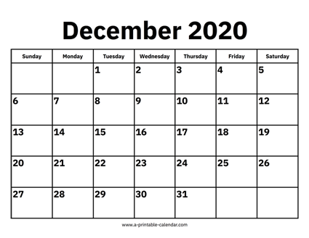
Study chapter 9 review chapter 8
Study chapter 10, review chapter 9
Review all bio material
Bio: Test at 8am

Slide 12
Papers
Plan backwards: start with due date
In agenda, put in any due dates: topic, sources, drafts
Think about outside help: writing conference, meet with professor
Write it down!

Slide 13
Papers: Example outline
Example:
Due date: December 11
Due to you: December 9
Draft 2: December 4
Writing conference: December 2
Draft 1: December 1
Office Hours: November 29
Annotated bibliography: November 23
Topic: November 17

Slide 14
FSP: Draft 1 final paper
Writing conference
Study chapter 10, review chapter 9
FSP: Draft 2 final paper
Study chapter 9 review chapter 8
Review all bio material
Have FSP paper due to me
FSP paper due
Bio: Test at 8am

Slide 15
What’s missing?
FSP: Draft 1 final paper
SPA office hours
PSY office hours
FSP: Draft 2 final paper
Classes
Work
Family obligations
TV shows?
Food
Breaks
Study chapter 9 review chapter 8
Writing conference
Study chapter 10, review chapter 9
Meet with PSY study group
Review all bio material
Bio: Test at 8am
Have FSP paper due to me
FSP paper due
Meet with Spanish study group
Study chapter 1-2 Spanish
Study chapter 3-4 Spanish
Study chapter 7-8 Spanish
Sweet sweet freedom
PSY Final: 8am
Spanish Final
Review PSY material
Review all Spanish Material

Slide 16
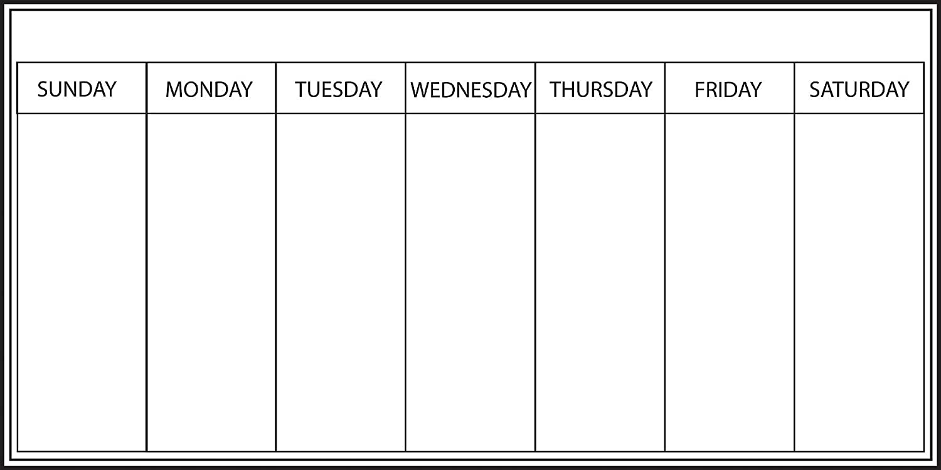
Work 8-2
Review Bio chapters 6-8: 9-11am
Lunch: 11-12
Review chapters 9-10: 12-2pm
Break 2-4
Meet with bio study group to practice questions 4-6
Dinner: 6-7
Relax 7-9
Bedtime!
BIO TEST 8am!
Make sure FSP paper is formatted correctly, upload to Canvas: 10am
10:30-12:00pm Review PSY flash cards
12:00-2pm lunch
2-5pm Do practice problems in PSY book
Meet with SPA study group 10am-12pm
Lunch 12pm-2pm
Study SPA chapter 2-4pm
Break 4-5pm
Pick up sibling from school 5pm
Dinner 6-8pm
Review PSY flash cards 8-9pm
Double check FSP paper submitted correctly before time it’s due
Work 8am-2pm
Break: 2-3pm
Study PSY chapter 3-5pm
Dinner 5-6:30
Review SPA vocab flashcards 6:30-8:30
Thursday Night Football
Review SPA chapters 1-2, study chapters 3-4: 9-11am
Lunch 11-12pm
Work 12-8pm
Relax 8-9pm
PSY flash cards 9-9:30pm
Break: 2-3pm
Study PSY 3-4:30pm
Break 4:30-5
Meet with PSY study group 5-7pm
Dinner 7-8pm
Sunday night football
11-2pm lunch and relax
Study SPA chapters 1-2: 2-4pm
Break: 4-5pm
5-6pm Review more SPA
6-8pm dinner

Slide 17
More Planning tips
Make the monthly plan, but readjust as necessary
Zoom in and make daily plan – this is where you can plan self care, breaks, food etc
At end of week, plan next week
At end of day, plan next day

Slide 18
Office hours
How many of you have used office hours?
Go over specific questions
Come prepared
If concerned about grade – ask what you can do, not what they can do for you

Slide 19
Study tips
Organize study materials – group quizzes, notes, slides by chapter or subject
Create a study guide for yourself – highlight vocabulary, answer end of chapter questions, make bullet-points of biggest takeaways
Explain the material to a friend not in the class
Review old tests: what did you get right? What did you get wrong? What types of studying or practice helped you in the past?

Slide 20
Study tips
Write keywords or new vocabulary in margins as you read over highlighted sections
Write or re-write your notes
Create outline for a reading – highlight key themes, takeaways, items to remember
Flash cards
Study groups: choose group wisely
Meet multiple times and set agenda
Come up with practice questions and practice answering together

Slide 21
Study tips: Resources
Tutoring Center
Center for Student Success
Office Hours
Study groups with other students

Slide 22
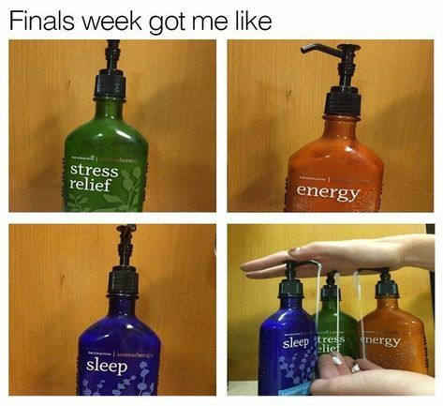
Self care

Slide 23
What is self care?
Specific to you
Care for entire self – mental break, physical break, emotional break
Don’t buy into finals clichés
The more you take care of yourself the better you’ll do on finals

Slide 24
My students
No class next week
Don’t forget to attend 2 events (This Week at TCNJ has information on events)
Last class: Dec 2 – assignment due

